Slide 1
Sales Forecasting

Slide 2
Objectives
After attending this session, you will be able to –
Delineate different ways to forecast Sales
Explain different models for forecasting sales
Explain seasonality and cyclic variation
Describe ARIMA models
Describe Smoothing models

Slide 3
Methods for Sales Forecasting
Jury of Executive Opinion
Sales Force Opinion
Test Marketing Result
Consumer’s Buying Plan
Market Factor Analysis
Expert Opinion
Econometric Model Building

Slide 4
Jury of Executive Opinion
Experienced executives having good knowledge of market factors try to predict expected future sales based on prevalent conditions
Executives are responsible while forecasting sale figures through estimates and experiences
It is simple and quick method and detailed data not needed
It is not based on factual data and it is difficult to draw final decision based on this approach
More or less, the method rests on guess-work and it may lead to wrong forecasts
It is difficult to break down the forecasts into products, markets etc.

Slide 5
Sales Force Opinion
Salesmen are required to make out an estimate of the sales in their respective territories for a given period
Salesmen are in close touch with the consumers and possess good knowledge about the future demand trend
All sales force estimates are processed, integrated, modified and a sales volume estimate formed for the whole market for the given period
Specializes knowledge is utilized and salesmen are confident and responsible to meet the quota fixed
This method facilitates to break down in terms of products, territories, customers, salesmen etc.
Success depends on the sales-person

Slide 6
Test Marketing Results
Products are introduced in a limited geographical area and results are studied
Taking results as base, sales forecast is made
This test is conducted as a sample on pre-test basis in order to understand the market response
System is reliable as forecast is based on actual result
Management can understand the defects and take steps to rectify
It is good for introducing new products in new territory
All markets are not homogeneous so result may not be repeated everywhere
Time-consuming and costly process

Slide 7
Consumers’ Buying Plan
Consumers are approached to know their likely purchases during the period under a given set of conditions
Suitable for market where few customers are available
This type of forecasting is generally adopted for industrial goods
Suitable for industries, which produce costly goods to a limited number of buyers-wholesalers, retailers, potential customers
First hand information is possible and user’s intention is known
It is good when the users are few, but not practicable when consumers are many

Slide 8
Market Factor Analysis
A company’s sales may depend on the behavior of certain market factors
Principal factors which affect the sales may be determined
By studying the behaviors of the factors, forecasting should be made
Sound method
Costly and time-consuming
Short run process

Slide 9
Expert Opinion
Many types of consultancy agencies have entered into the field of sales
The consultancy agency has specialized experts in the respective fields
The consultancy agencies conduct market researches and possess ready-made data
Firms may make use of opinions of such consultancy experts
These opinions may be carefully analysed by the company and a sound forecasting is made
Forecasting is quick, inexpensive and accurate
Specialized knowledge is utilized
Success of forecasting depends upon competency of experts

Slide 10
Econometric Model Building
Mathematical approach of study and ideal way to forecast sales
It includes time-series analysis and studying of historical data
No guess-work creeps in
The method is simple and inexpensive
This is an objective method

Slide 11
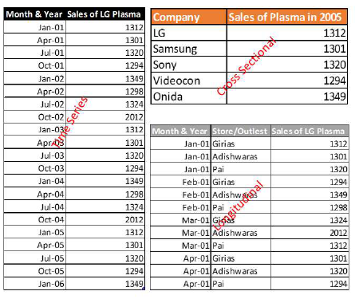
Different Types of Data

Slide 12
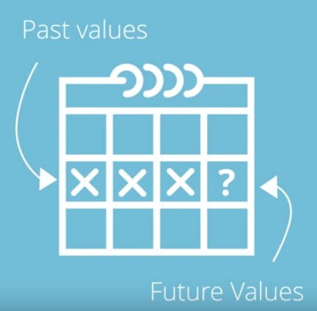
What is Time Series Forecasting ?
Time Series Forecasting is the use of statistical models to predict future values based on past results.

Slide 13

What kind of variables can we forecast ?
Any variable that can be tracked and collected overtime.

Slide 14
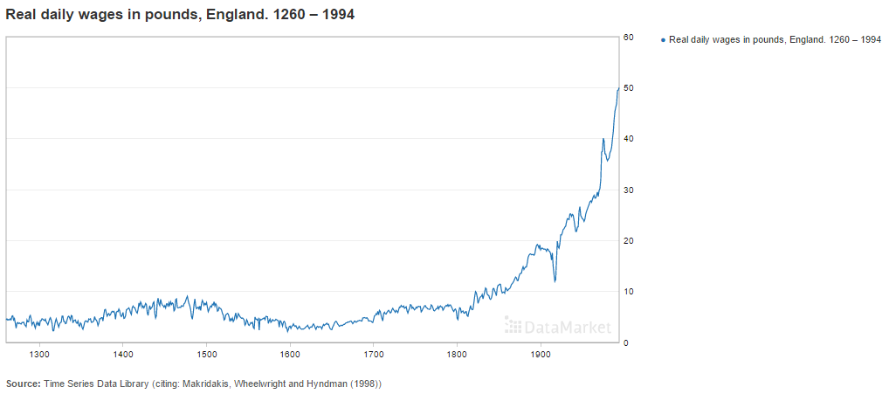
What kind of variables can we forecast ?
Annual Time Series Data
https://datamarket.com/data/set/22ta/real-daily-wages-in-pounds-england-1260-1994#!ds=22ta&display=line

Slide 15
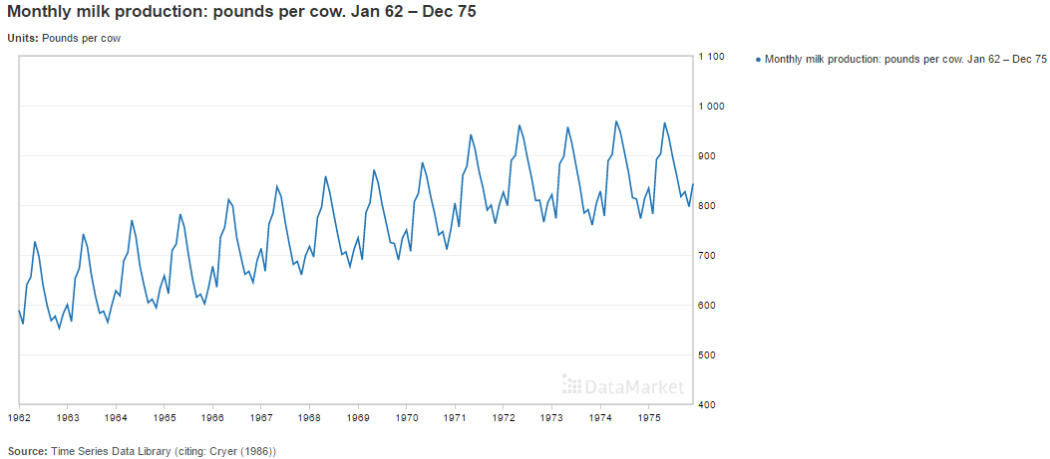
What kind of variables can we forecast ?
Monthly Time Series Data
https://datamarket.com/data/set/22ox/monthly-milk-production-pounds-per-cow-jan-62-dec-75#!ds=22ox&display=line

Slide 16
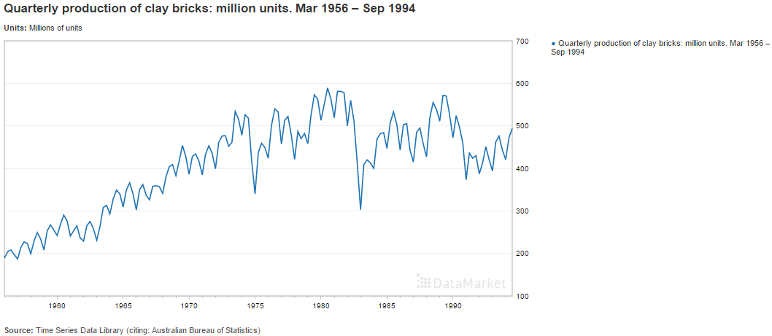
What kind of variables can we forecast ?
Quarterly Time Series Data
https://datamarket.com/data/set/22vd/quarterly-production-of-clay-bricks-million-units-mar-1956-sep-1994#!ds=22vd&display=line

Slide 17
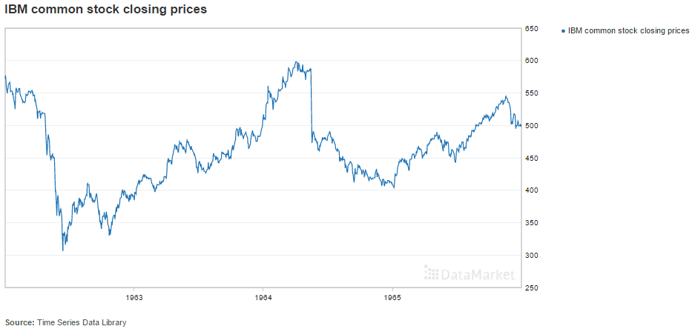
What kind of variables can we forecast ?
Daily Time Series Data
https://datamarket.com/data/set/231i/ibm-common-stock-closing-prices#!ds=231i&display=line

Slide 18
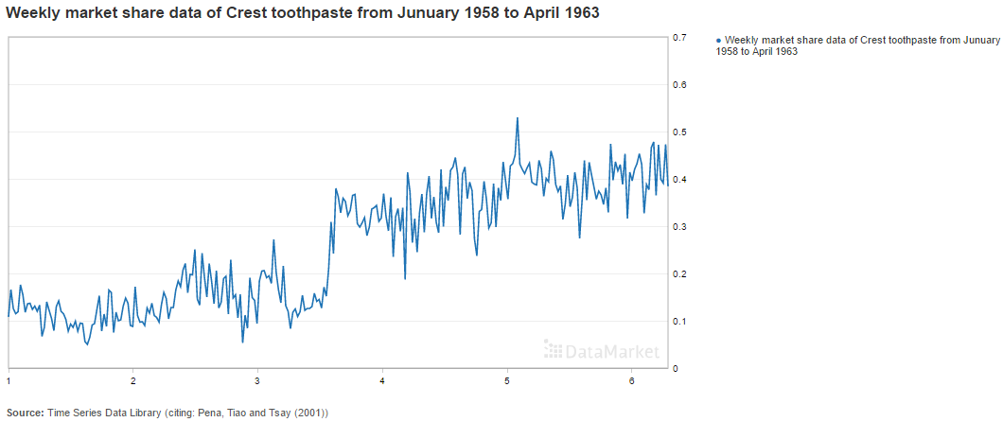
What kind of variables can we forecast ?
Weekly Time Series Data
https://datamarket.com/data/set/22p2/weekly-market-share-data-of-crest-toothpaste-from-junuary-1958-to-april-1963#!ds=22p2&display=line

Slide 19
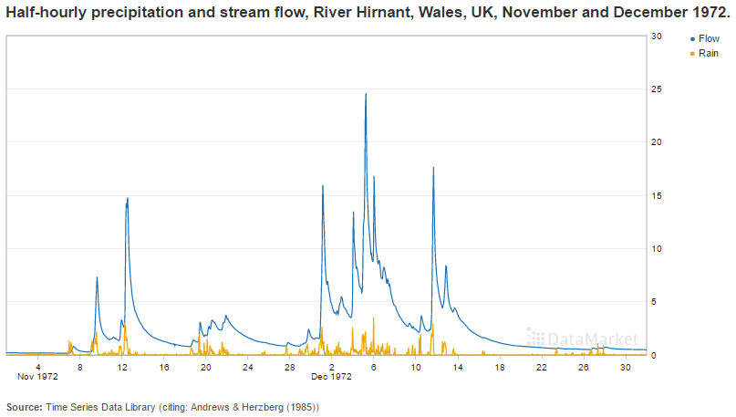
What kind of variables can we forecast ?
Half Hourly Time Series Data
https://datamarket.com/data/set/232a/half-hourly-precipitation-and-stream-flow-river-hirnant-wales-uk-november-and-december-1972#!ds=232a!2eqz&display=line

Slide 20
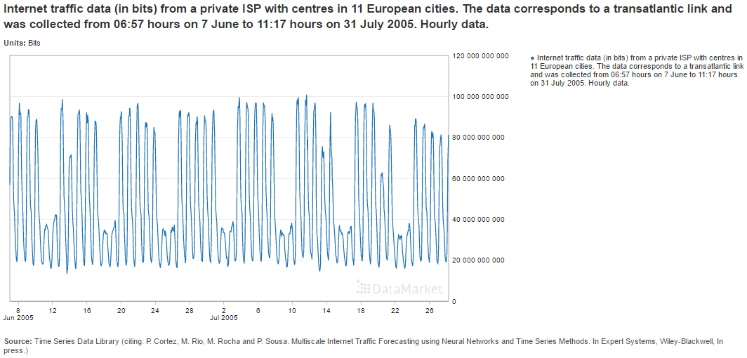
What kind of variables can we forecast ?
Hourly Time Series Data
https://datamarket.com/data/set/232j/internet-traffic-data-in-bits-from-a-private-isp-with-centres-in-11-european-cities-the-data-corresponds-to-a-transatlantic-link-and-was-collected-from-0657-hours-on-7-june-to-1117-hours-on-31-july-2005-hourly-data#!ds=232j&display=line

Slide 21
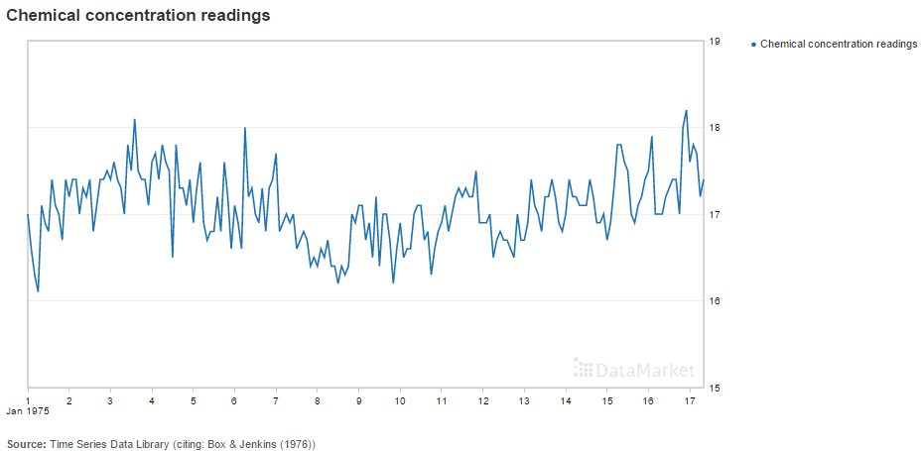
What kind of variables can we forecast ?
Fixed Interval Time Series Data
https://datamarket.com/data/set/232f/chemical-concentration-readings#!ds=232f&display=line

Slide 22
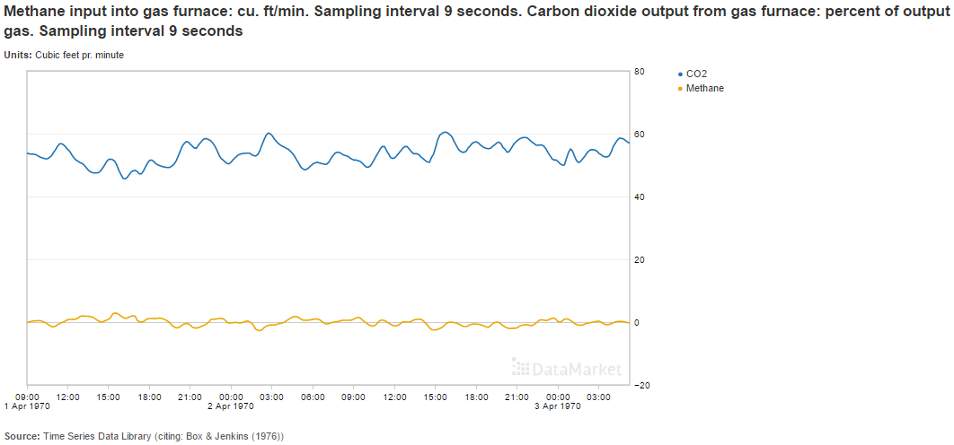
What kind of variables can we forecast ?
Fixed Interval Time Series Data
https://datamarket.com/data/set/2372/methane-input-into-gas-furnace-cu-ftmin-sampling-interval-9-seconds-carbon-dioxide-output-from-gas-furnace-percent-of-output-gas-sampling-interval-9-seconds#!ds=2372!2juz&display=line

Slide 23
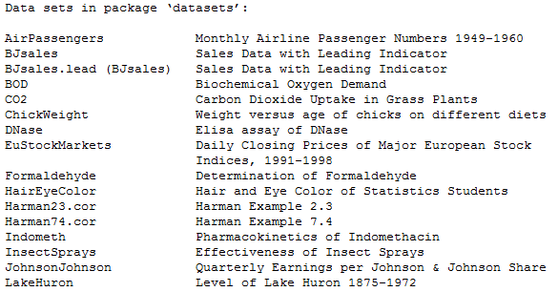
Hands-On Time Series Data
Getting Data
We can get a list of available datasets in R using the data() function.

Slide 24
Hands-On Time Series Data
Exploring raw time series
We can use the print() function to get the Start, end and frequency of the data.
We can use head(), tail() and length() functions to further explore the data.
Visualize the time series using plot() function.
Use time() function to create the vector of times at which a time series was sampled.
Use cycle() to give the positions in the cycle of each observation.
Use frequency() to return the number of samples per unit time.
Use deltat() to return the time interval between observations.
Use mean() to find the sample mean of the data.
Other useful time series functions.

Slide 25
R console
#CHAPTER 1
# Default data library in R
data()
print(EuStockMarkets)
# Getting Data into R from Data Market
install.packages("rdatamarket")
library(rdatamarket)
#View the Data
data <- dmlist("http://data.is/1RvZGQL")
# Is this data a time series Object ?
is.ts(data)
# Get Time Series Data
tsdata<-as.ts(dmseries("http://data.is/1RvZGQL"))
# Is this data a time series Object ?
is.ts(tsdata)
# Time Series Object
print(ts(tsdata))
# Time Series first 10 observations
head(tsdata, 10)
# Time Series last 10 observations
tail(tsdata, 10)
# Time Series number of observations
length(tsdata)

Slide 26
R Code
# Time Series start of observations
start(tsdata)
# Time Series start of observations
end(tsdata)
# Vector of times at which a time series was sampled
time(tsdata)
# Return the time interval between observations
deltat(tsdata)
# Return the number of samples per unit time
frequency(tsdata)
# Return the positions in the cycle of each observation
cycle(tsdata)
# Caculate the sample mean
mean(tsdata)
# Get the value distribution of the observations.
summary(tsdata)
# Visualize the Time Series
plot(tsdata)
# Visualize and edit the Time Series Axis names
plot(tsdata, xlab = "Yr-month", ylab = "Bookings")
# # Visualize and edit the Time Series plotting type (Default type in "l")
plot(tsdata, xlab = "Yr-month", ylab = "Bookings", type = "b")

Slide 27
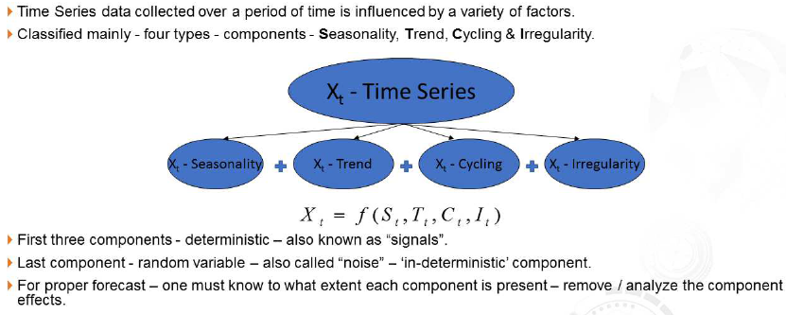
Components of Time-series Data

Slide 28
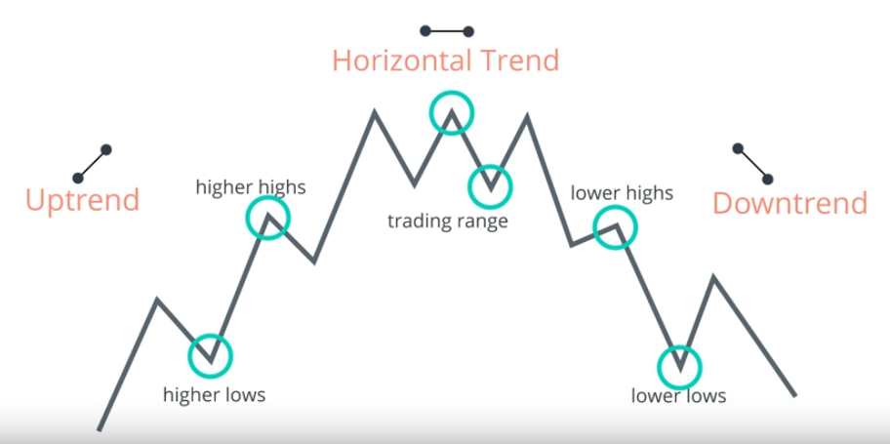
Trends
Trend is a gradual shift or movement to relatively high and low values over a long period of time.
Higher highs and higher lows in the plot signify uptrend.
Lower highs and lower lows in the plot signify downtrend.
If there is no trend it is called horizontal or stationary trend.

Slide 29
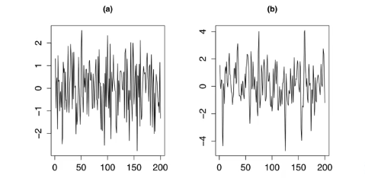
Trend types – Stationary / horizontal trends

Slide 30
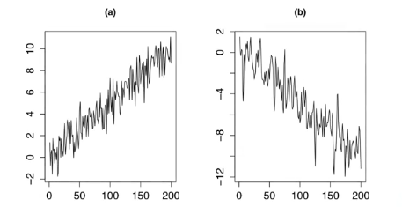
Trend types – Linear trends

Slide 31
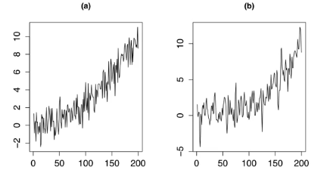
Trend types – Rapid growth trends

Slide 32
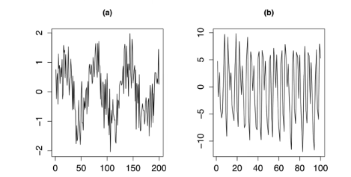
Trend types – Periodic / sinusoidal trends

Slide 33
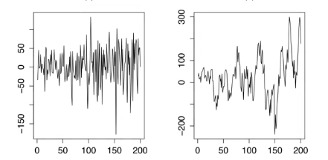
Trend types – Variance

Slide 34
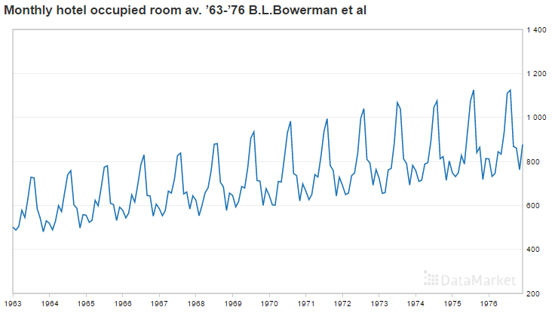
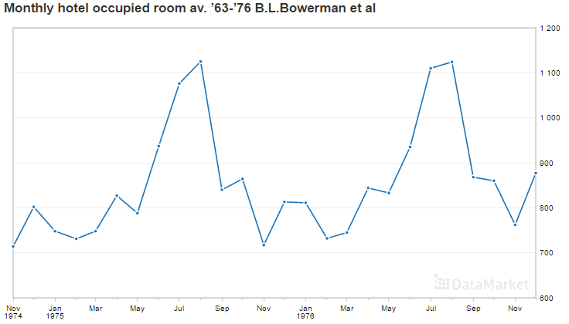
Seasonality
Series that exhibit a repeating pattern at fixed intervals of time within a one year period is said to have seasonal pattern.

Slide 35
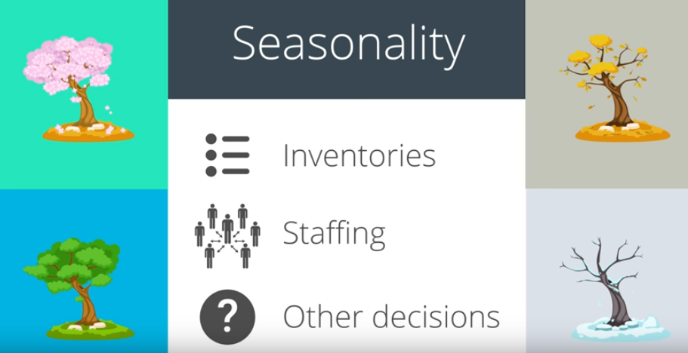
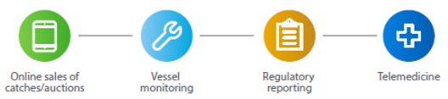
Seasonality
Seasonality is a common concept seen in many time series that depend on the seasons of the year. Ex: winter, summer, holiday, Christmas, etc.
Air conditioner sales/usage, winter coat production, hotel bookings, cool drinks sales, etc.
Companies that understand the seasonal patterns of their business can make decisions that coincide with expected change in business.

Slide 36
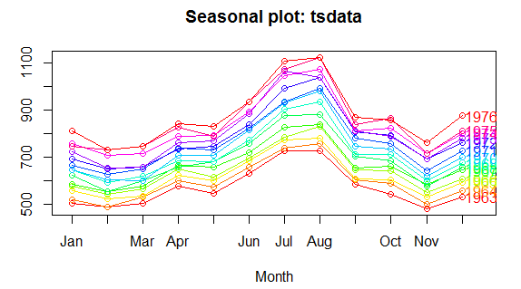
Seasonality Plot
Vertical Axis Y is the target variable.
Horizontal Axis X is the shows seasonality.
Example: For monthly data, all months are plotted in chronological order on X Axis.
Something like a time plot except that the data from each season are overlapped.
Use seasonplot() from forecast library to plot seasonality plot.

Slide 37
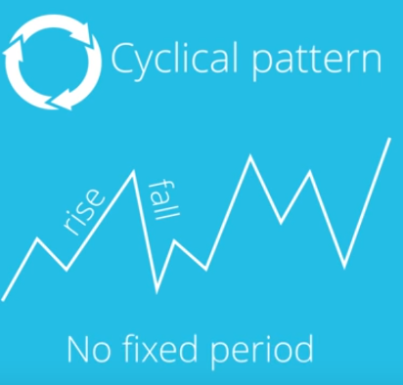
Cyclic Pattern
Patterns in data that do not fall in the same calendar year.
Cyclical patterns exist when data exhibits rises and falls that are not of a fixed period.
Examples are business like cycles, lasting several years, length of the current cycle is unknown before hand.

Slide 38
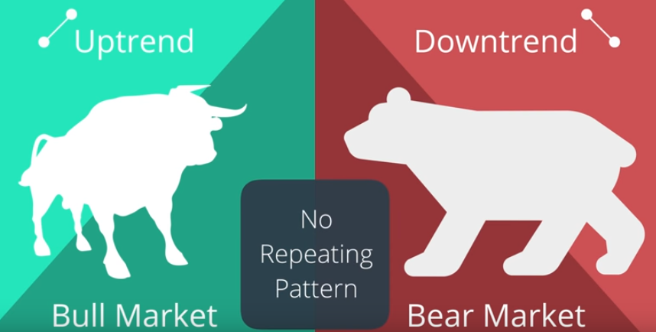
Cyclic Pattern
In Econometrics and finance, times of recession and expansion of the stock market reveal cyclical patterns.
A cyclical uptrend is called bull market and a cyclical downtrend is called a bear market.
Occupy multiple years and no fixed or repeating pattern within each year.

Slide 39
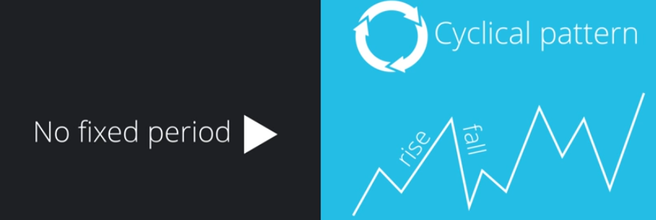

Cyclic Pattern vs Seasonal Pattern

Slide 40
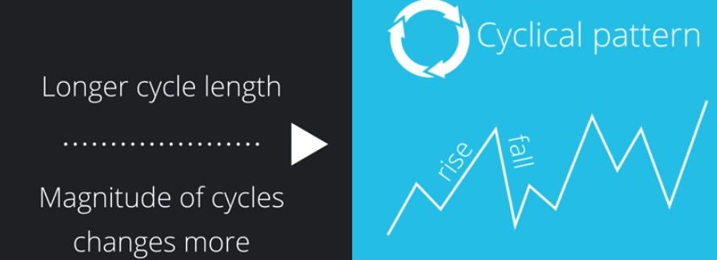
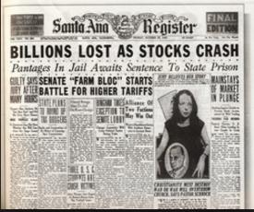
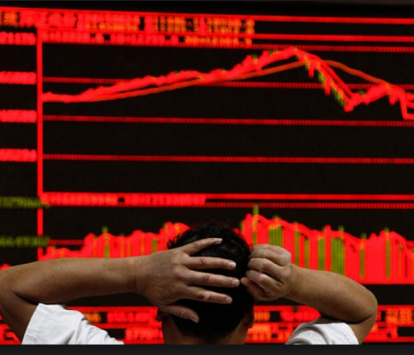
Cyclic Pattern vs Seasonal Pattern
Cyclical patterns are much harder to predict.
Stock market example: usually decline comes sudden and as a surprise to most.
https://en.wikipedia.org/wiki/List_of_stock_market_crashes_and_bear_markets

Slide 41
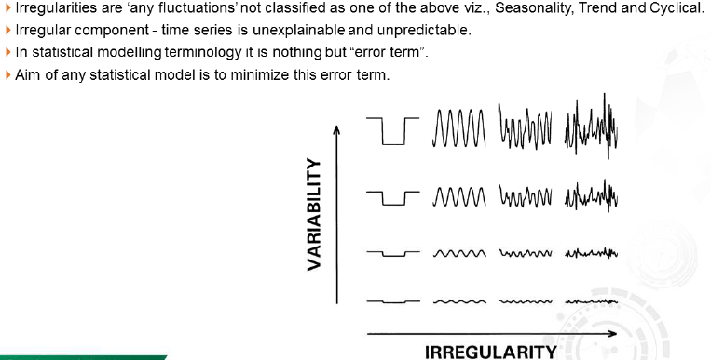
Irregular Component

Slide 42
What is Lead and Lag in Time-series?

Slide 43
Hands-On Time Series patterns
Exploring time series patterns
# Get Time Series Data
tsdata<-as.ts(dmseries("http://data.is/1RvZGQL"))
install.packages("forecast")
library(forecast)
# Visualize seasonal plot
seasonplot(tsdata,col=rainbow(13),year.labels = year.labels)
# Visualize seasonal sub-series plot or month plot.
monthplot(tsdata)
We can use the seasonplot() function from the forecast library to get visualize the seasonality plot.
We can use monthplot() function from the forecast library to visualize the means of the seasons.

Slide 44
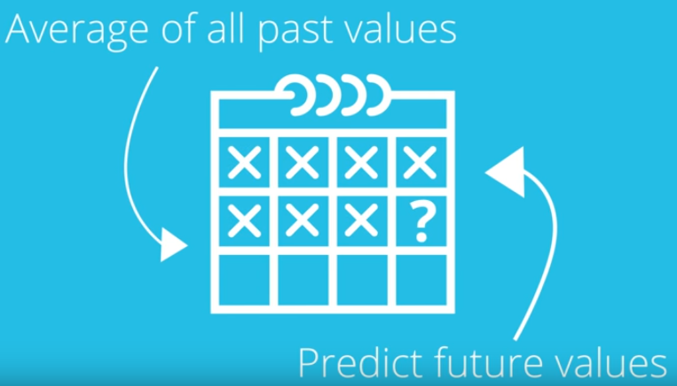
Simple forecasting
Method 1 : Average method.
The forecast of all future values are equal to the average of all past vales.
In essence, what will happen tomorrow is the average of everything that has happened up till now.
Can we better this approach ?

Slide 45
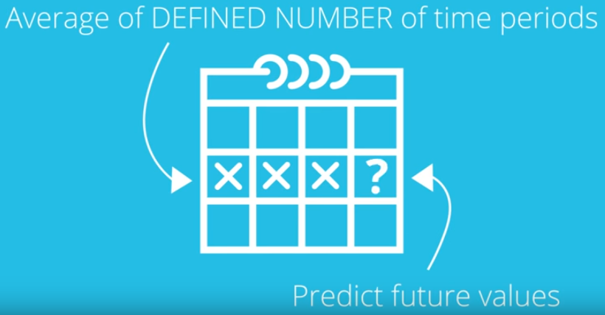
Simple forecasting
Method 2 : Moving Average method.
The forecast of all future values are equal to the average of the time series for a defined number of time periods.
In essence, what will happen tomorrow is the average of everything that has happened in last 3(n) months.
Can we better this approach ?

Slide 46
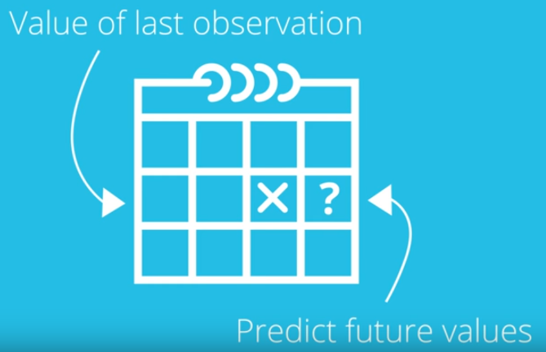
Simple forecasting
Method 3 : Naïve method.
The forecast of all future values are equal to the value of the last observation.
In essence, what will happen tomorrow is what happened yesterday.
Ok when data is insufficient, but can we better this approach ?

Slide 47
Simple forecasting
Method 4 : Seasonal Naïve method.
The forecast of all future values are equal to the value of the last year’s observation in the same month.
In essence, what will happen tomorrow is what happened same day last year.
Assumes magnitude of the seasonal pattern will remain constant.

Slide 48
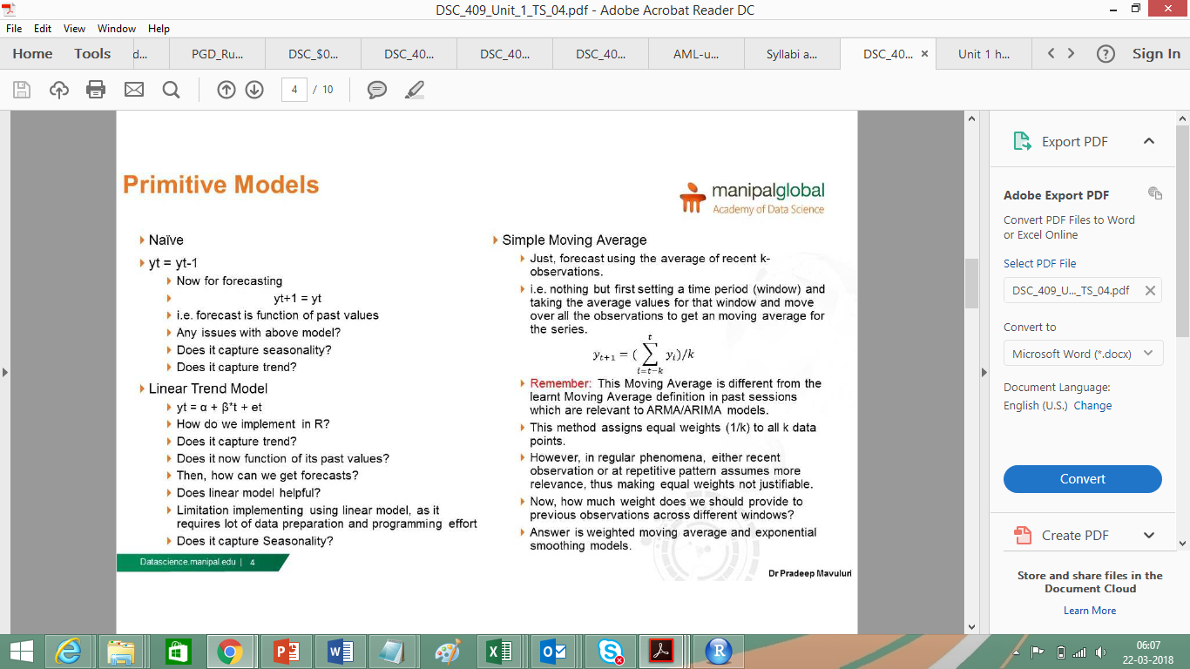
Simple forecasting
Method 5 : Simple Linear Model

Slide 49

Simple forecasting Pitfalls
Does not take trend into account.
Does not take Variance into account.
Does not take Seasonality into account.
Does not take Variance into account.
Does not take Correlation into account.
It would be nice to have a time series with no trend, no seasonality and a constant variance.

Slide 50
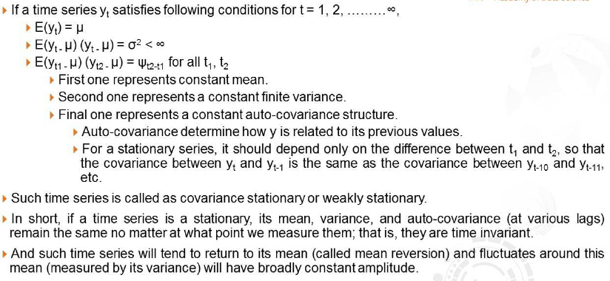
Stationary and Non-stationary Time-series

Slide 51
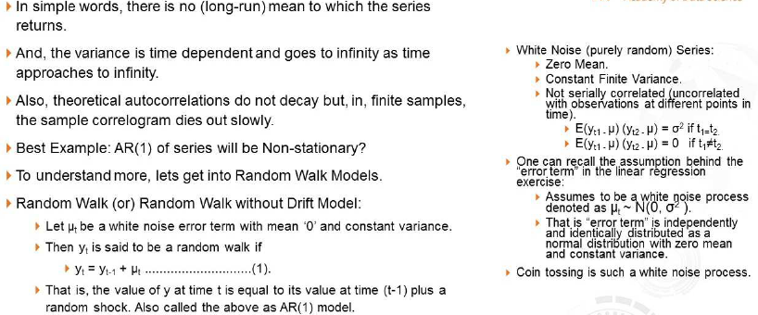
Stationary and Non-stationary Time-series

Slide 52
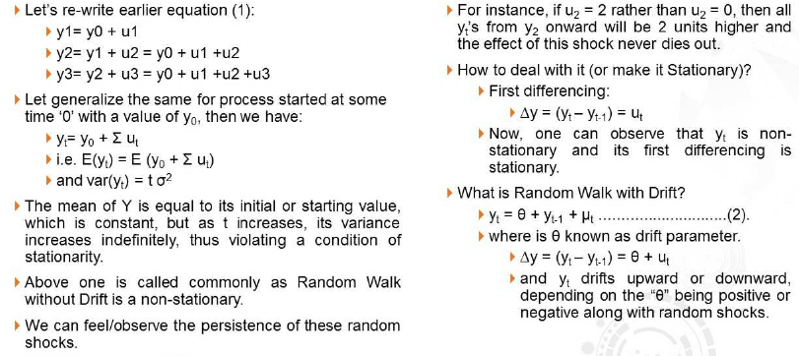
Stationary and Non-stationary Time-series

Slide 53
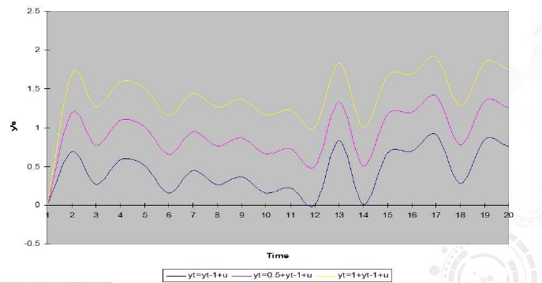
Random Walk with and without Drift

Slide 54
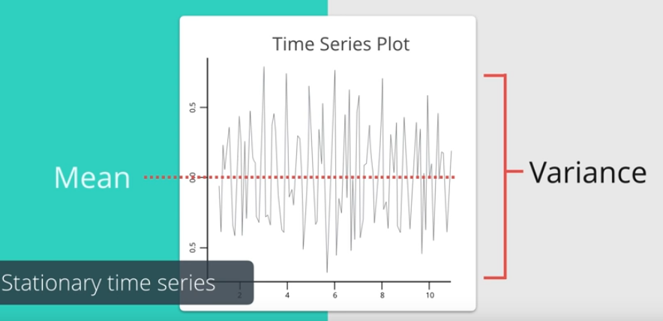
Stationary Series
A time series where the mean and variance are constant overtime.
ARIMA models make adjustments to its calculations to make the series stationary.

Slide 55
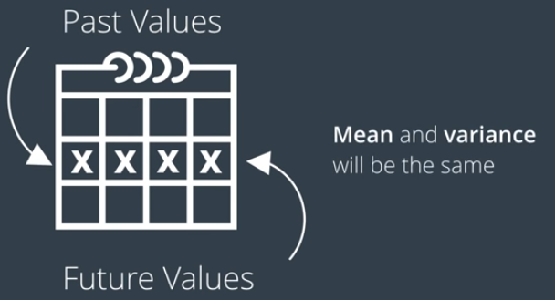
Stationary Series
A stationary series is relatively easy to predict as its mean and variance will be the same in the future as they have been in the past.

Slide 56
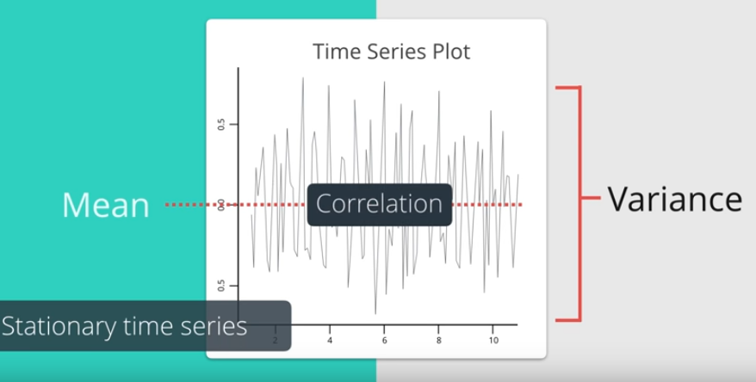
Stationary Series
We obtain meaningful statistics such as mean, variances and correlation with other variables.
Only useful if series is stationary.

Slide 57
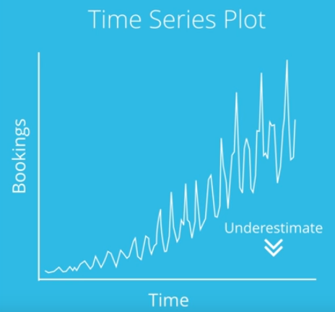
Stationary Series
Example if a series is consistently increasing over time, then sample mean and variance will also grow to the size of the sample.
Hence forecasting models will always end up under estimating the future values.
This is the reason we need a stationary data set.

Slide 58
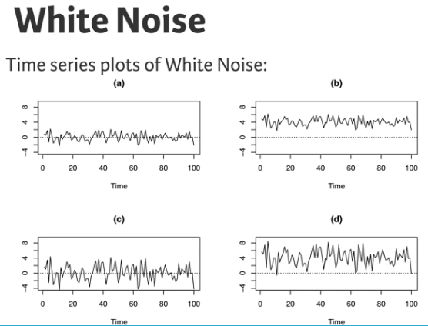
White Noise(WN) Model
WN model is the simplest example of a stationary process.
It has a fixed constant mean.
It has a fixed constant variance.
No correlation over time.

Slide 59
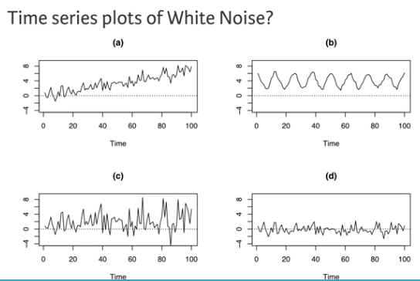
White Noise(WN) Model

Slide 60
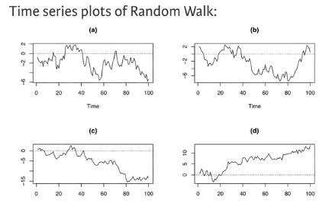
Random Walk (RW) Model
RW model is the simplest example of a non stationary process.
No specified mean.
No specified variance.
Strong dependence over time.
Changes or increments are white noise, with high persistence.
Each observation is closely related or similar to it’s immediate neighbour.

Slide 61
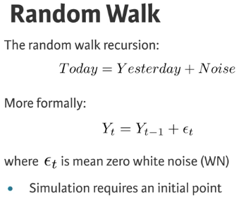
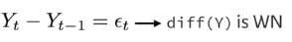
Random Walk (RW) Model

Slide 62
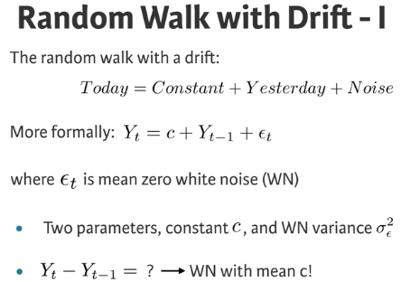
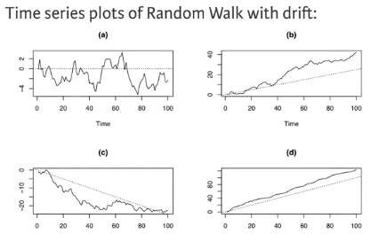
Random Walk (RW) Model

Slide 63
Transformation Techniques or Differencing
Differencing is a method of transforming a non-stationary time series to a stationary one. This is an important step in preparing data to be used in an ARIMA.
Differencing and the II Term of ARIMA: The number of times of differencing needed to render the series stationary will be the differenced I(d) term in our ARIMA model.
The best way to determine whether or not the series is sufficiently differenced is to plot the differenced series and check to see if there is a constant mean and variance.

Slide 64
Transformation Techniques or Differencing
De trend a time series, removing the trend in a time series.
Remove increasing variance in time series, log differencing.
Remove seasonal patterns in time series, seasonal differencing or seasonally adjusted time series.

Slide 65


Transformation Techniques or Differencing
# Get Time Series Data
tsdata<-as.ts(dmseries("http://data.is/1RvZGQL"))
ts.plot(tsdata)
#Removing Trends
tsdatadiff1<-diff(tsdata)
ts.plot(tsdatadiff1)

Slide 66

Transformation Techniques or Differencing
# Get Time Series Data
tsdata<-as.ts(dmseries("http://data.is/1RvZGQL"))
ts.plot(tsdata)
#Removing Variability
tsdatalog<-log(tsdata)
ts.plot(tsdatalog)

Slide 67

Transformation Techniques or Differencing
# Get Time Series Data
tsdata<-as.ts(dmseries("http://data.is/1RvZGQL"))
ts.plot(tsdata)
#Remove seasonality
tsdataseason1<-diff(tsdata, lag = 12)
ts.plot(tsdataseason1)

Slide 68



Introduction to ARIMA

Slide 69

Introduction to ARIMA
ARIMA models forecast future points based upon the construction of 3 components, Autoregressive (AR), a differencing/Integrated (I) and a Moving Average (MA) component.
ARIMA models are displayed as ARIMA(p,d,q).

Slide 70


Introduction to ARIMA
ARIMA models are displayed as ARIMA(p,d,q).
P : represents the amount of periods to lag for in the ARIMA calculation.
Example using p=2, means we will be using the 2 previous periods of the time series for out Autoregressive part.

Slide 71

Introduction to ARIMA
Purely AR models will look like a linear regression with the predictive variable are the certain number of previous periods which is represented

Slide 72

Introduction to ARIMA
ARIMA models are displayed as ARIMA(p,d,q).
d : represents the differencing term to transform the time series to a stationary series.
d: represents the number of transformations applied to the series to make it stationary.

Slide 73

Introduction to ARIMA
ARIMA models are displayed as ARIMA(p,d,q).
q : refers to the lag in the error component.
Error component is that part of the time series not explained by trend or seasonality.
MA models look like linear regression models but the predictive variables are the previous q periods of errors.

Slide 74
Autocorrelation
Covariance : Positive and negative, Depends on scale of the variables. Hard to interpret small or large.
Correlations: Standardized version of covariance, Positive and negative do not depend on scale of the variables. Always between 1 and -1.
Correlations 1,0 and -1
#Covariance
cov(1:10,11:20)
#Correlation
cor(1:10,11:20)
#Correlation
cov(1:10,11:20)/sd(1:10)*sd(11:20)

Slide 75
Autocorrelation
Very powerful tool for time series analysis and constructing the ARIMA model.
Helps study how each observation is related to its recent past.
Process with greater Autocorrelation are more predictable.
Correlation of the observation with it’s past values.

Slide 76

Autocorrelation
The Plot used to visualize autocorrelations is called correlogram and is generated by the Autocorrelation function (ACF).
Used to see the correlation of the points up to, and including, the lag unit.
Plot shows us how far the time series is correlated with itself.

Slide 77

Autocorrelation
This series is not differenced and has a slow decay towards 0 correlation.
Meaning that current values are much more correlated to recent values than values further in the past.
Tells us it is not stationary and has to be differenced to become stationary.

Slide 78

Autocorrelation
The same dataset with first difference.
Lag 1 is significant, however the significance after lag 1 is much less and hence stationary.

Slide 79
Autocorrelation
The ACF plot is used to determine if we should use AR or MA or Both components.
Also to determine the number of lags (p) to use.

Slide 80


Autocorrelation
Selecting AR and MA components in ARIMA model.
Generally ARIMA uses either the AR term or the MA term. Models that use both terms are less common.
If the model shows Positive correlation at lag 1 then AR terms are best.
If it has Negative correlation at lag 1 then MA terms are best.
The decay or cut off at the ACF will give us hints at what terms to use.

Slide 81

Autocorrelation
Selecting AR and MA components in ARIMA model.
Generally ARIMA uses either the AR term or the MA term. Models that use both terms are less common.
If the model shows Positive correlation at lag 1 then AR terms are best.
If it has Negative correlation at lag 1 then MA terms are best.
The decay or cut off at the ACF will give us hints at what terms to use.

Slide 82


Partial Autocorrelation
The correlation between 2 variables controlling for the values of another set of variables.
Better confirm our terms.
Example : If we consider 3 consecutive values of a time series having some autocorrelation with each other.
Correlation between current and lag 2 is autocorrelation.
The same calculation for controlling for lag 1 is Partial Autocorrelation.

Slide 83

Partial Autocorrelation
PACF : Partial Autocorrelation plot.
Significant at lag 1.
Inspecting PACF will give us hint as to how many AR terms to use to explain the autocorrelation in the series.

Slide 84


Partial Autocorrelation
If PACF drops at lag k then it indicates to a AR(k) model.
If it drops of more gradually it suggests an MA model.
# Get Time Series Data
tsdata<-as.ts(dmseries("http://data.is/1RvZGQL"))
ts.plot(tsdata)
# ACF
acf(tsdata,plot = TRUE)
# PACF
pacf(tsdata,plot = TRUE)

Slide 85


Autoregressive Component
A purely AR model forecast variables based on the combination of the past values of the variables.
AR models act like linear regression models and the more AR terms means more previous periods used in the forecast.
Once a series is stationary the next step is to determine the number of AR terms required to account for any autocorrelation left in the series .
The ACF and PACF plots help in determining number of AR terms to include.

Slide 86


Autoregressive Component
However, this alone cannot lead to the best model.
These plots help in choosing a few models to test against each other.
The ACF plot will show autocorrelation decaying towards 0.
PACF plot will cut off quickly towards 0.

Slide 87

Autoregressive Component
If the ACF of a stationary time series shows positive at lag 1 – AR terms are best.

Slide 88



R console
#CHAPTER 3
#AR model estimation and forecasting
install.packages("Ecdat")
library(Ecdat)
data(Mishkin,package = "Ecdat")
#explore and inspect data series
inflation <-as.ts(Mishkin[,1])
ts.plot(inflation)
acf(inflation)

Slide 89


R console
AR_inflation<- arima(inflation,order = c(1,0,0))
print(AR_inflation)
AR_inflation_fitted<-inflation - residuals(AR_inflation)
points(AR_inflation_fitted,type = "l", col = "red", lty = 2)
stl(inflation, s.window="periodic")
plot(stl(inflation, s.window="periodic"))

Slide 90

R console
#predict 1 step ahead
predict(AR_inflation)
#predict n steps ahead
predict(AR_inflation, n.ahead = 6)

Slide 91

Moving Averages Component
A series displays moving averages behaviour if it undergoes random jumps whose affects are felt at 2 or more consecutive periods.
These jumps are represented in the error that is calculated in ARIMA model.
This is what the MA component will lag for.
A purely MA model will smooth out the impact of the sudden movements in the data.

Slide 92



Moving Averages Component
A weighted sum of the current and previous noise is called simple moving average.
Indicators that we should use for MA terms in a model are :
A MA series is negatively correlated at lag 1.
ACF cuts of sharply after a few lags.
PACF that decreases out more gradually.

Slide 93



R console
#CHAPTER 3
#explore and inspect data series
inflation <-as.ts(Mishkin[,1])
ts.plot(inflation)
acf(inflation)
inflation_chages<-diff(inflation)
ts.plot(inflation_chages)
acf(inflation_chages, lag.max = 24)

Slide 94


R console
MA_inflation_changes<- arima(inflation_chages,order = c(0,0,1))
print(MA_inflation_changes)
MA_inflation_fitted<-inflation_chages - residuals(MA_inflation_changes)
ts.plot(inflation_chages)
points(MA_inflation_fitted,type = "l", col = "red", lty = 2)

Slide 95

R console
#predict 1 step ahead
predict(MA_inflation_changes)
#predict n steps ahead
predict(MA_inflation_changes, n.ahead = 6)

Slide 96


Integrated Component
The Integrated component term is the number of times the data set was differenced to make it stationary.
If a series must be differenced to make it stationary then we consider it integrated.
If the data was differenced once then we say the I term (d) has 1 component.

Slide 97

ARIMA Components
Putting it all together,
AR term – p
I term - d
MA term – q
ARIMA(p,d,q) = ARIMA(1,1,0)

Slide 98
Constructing an ARIMA model
Step 1 - Check stationarity: First thing to do is to visualize the data.
Step 2 - Difference: Remove Trend and seasons by difference and observe the resulting plot.
Step 3 - Select AR and MA terms: Let's take a look at the ACF and PACF of the seasonally differenced dataset.
Step 4 - Build the model: Build the model using the ARIMA tool and set the number of periods to forecast.
Step 5 - Validate model: Compare the predicted values to the actuals in the validation sample

Slide 99

R console
# ARIMA MODELING USE CASE 1
#STEP 1 Explore series
data(AirPassengers)
start(AirPassengers)
frequency(AirPassengers)
end(AirPassengers)
summary(AirPassengers)
print(AirPassengers)
#STEP 2 Visualize series
plot(AirPassengers)
abline(reg=lm(AirPassengers~time(AirPassengers)))

Slide 100
R console
# ARIMA MODELING USE CASE 1
#STEP 3 Stationarize the Series
install.packages("tseries")
library(tseries)
adf.test(diff(log(AirPassengers)), alternative="stationary", k=0)
#STEP 4 Determine AR and MA terms
acf(AirPassengers)
acf(log(AirPassengers))
acf(diff(log(AirPassengers)))
pacf(diff(log(AirPassengers)))

Slide 101
R console
# ARIMA MODELING USE CASE 1
##STEP 5 Model fitting and prediction
fit <- arima(log(AirPassengers), c(0, 1, 1),seasonal = list(order = c(0, 1, 1), period = 12))
pred <- predict(fit, n.ahead = 10*12)
#STEP 6 Validate model
ts.plot(AirPassengers,2.718^pred$pred, log = "y", lty = c(1,3))
print(fit)
AIC(fit)
BIC(fit)

Slide 102

Smoothing Models

Slide 103

Smoothing Models

Slide 104


